Slide 1
Computer Networks
Gu Qing, Xia Nai
Nanjing University
2011-9-13

Slide 2
Chapter 6. Congestion Control and QoS
Network Congestion
Congestion Control in FR
Traffic Management in ATM
Internet QoS
Resource Allocation and RSVP
Differentiated Services
Notes:
Resource reservation protocol

Slide 3
Network Congestion
Congestion
Number of packets transmitted through the network approaches the packet handling capacity of the network
One or more switches/routers becomes overloaded
Generally 80% utilization is critical
Congestion control
Keep number of packets below level at which performance falls off dramatically

Slide 4
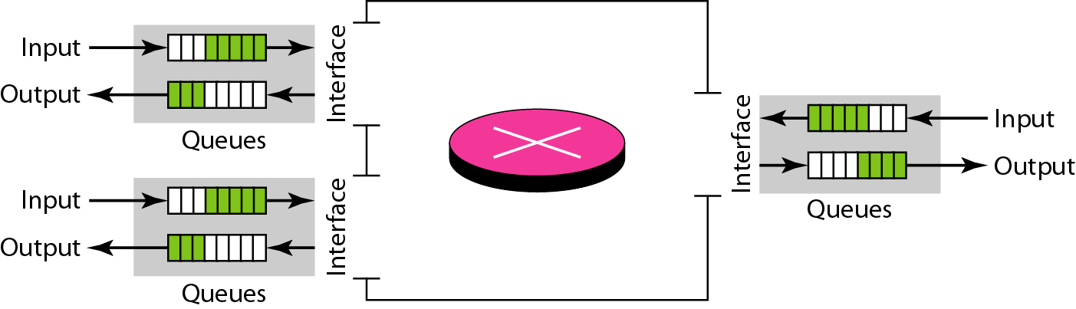
Queues at a Switch
Switch overloads because receiving packets faster than it can forward

Slide 5
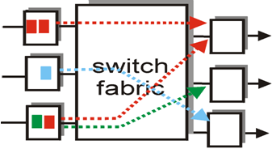
Causing Congestion
Congestion at switch
Bursty traffic / poor topology
Packet arrival rate exceeds the outgoing link capacity
Packet processing rate < packet arriving rate
Insufficient memory to store arriving packets
Effects caused at congested switch
Discard queued packets to make room for new comings
Prevent additional packets from entering the congested port (link-layer flow control)

Slide 6
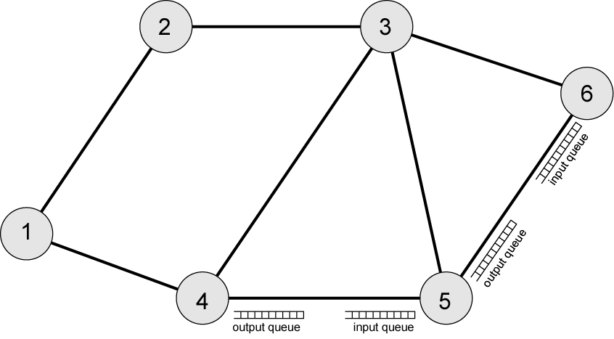
Interaction of Queues
Congestion propagation
Notes:
存储资源占用、执行时间占用

Slide 7
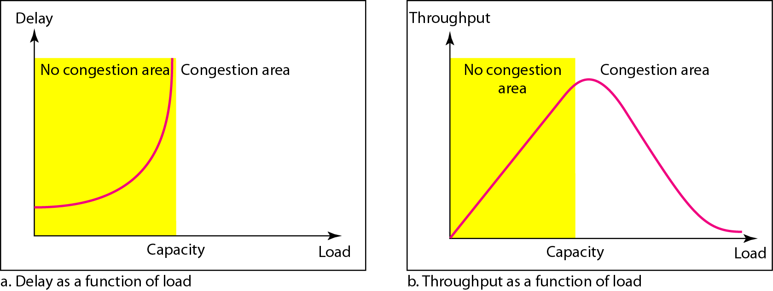
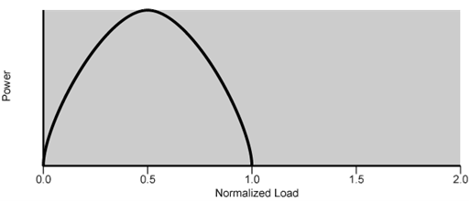
Network Utilization
Delay and Throughput vs. Network Load
Communication Power
Notes:
不丢失分组

Slide 8
Bottleneck Effect
1
5
A
3
4
B
2
6
Assume all the links have similar capacity, and run in full for both direction
Then switches 3 and 4 will be in congestion

Slide 9
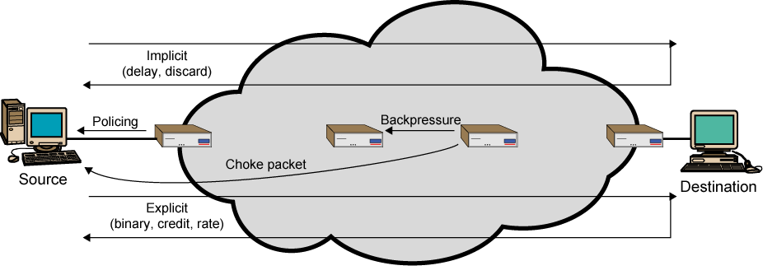
Mechanisms for Congestion Control
Notes:
Policing最有效，但实现最难

Slide 10
Possible Mechanisms
Choke Packet
Backpressure
Warning bit
Congestion window
Random early discard
Traffic shaping

Slide 11
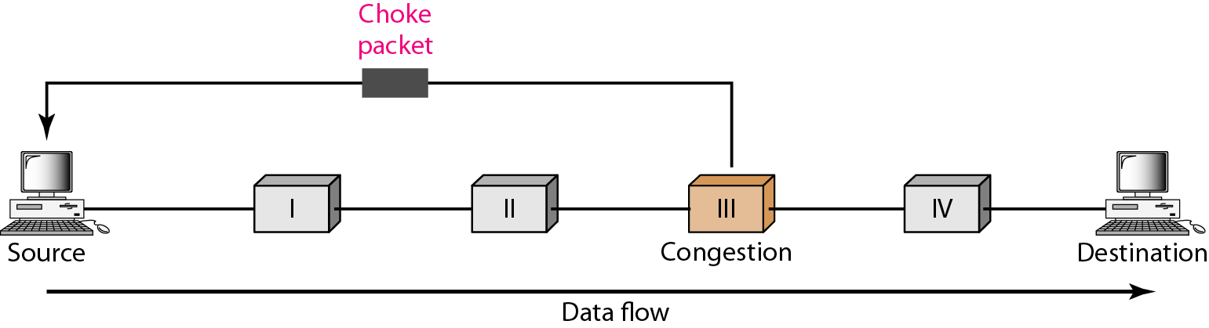
Choke Packet
Control packet
Generated at congested node
Sent to source node
ICMP source quench
From router or destination, sent for every discarded packet
Notes:
缓冲利用率>85%

Slide 12
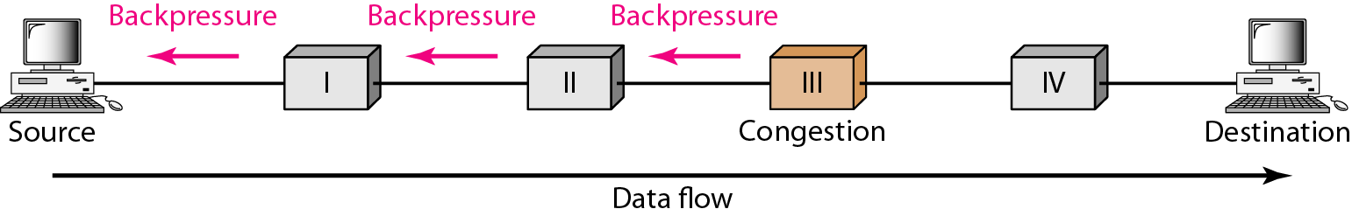
Backpressure
Hop-by-Hop Choke Packets
Propagation time > transmission time (long distance or high speed link)
Choke packets from router to source are not effective
Require each hop to reduce its transmission

Slide 13
Warning Bit
Special bits set in the packet header by switches
Alerts end systems of increasing congestion
End systems take steps to reduce offered load
Backwards
Congestion avoidance in opposite direction to congested packet
Assume congestion will burst up quickly
Forwards
Congestion avoidance in same direction as congested packet
Assume congestion will cumulate slowly
Notes:
forward简单，backward需要识别

Slide 14
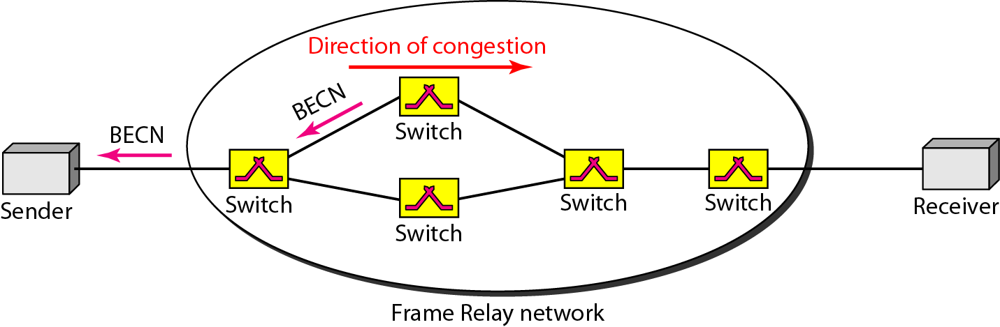
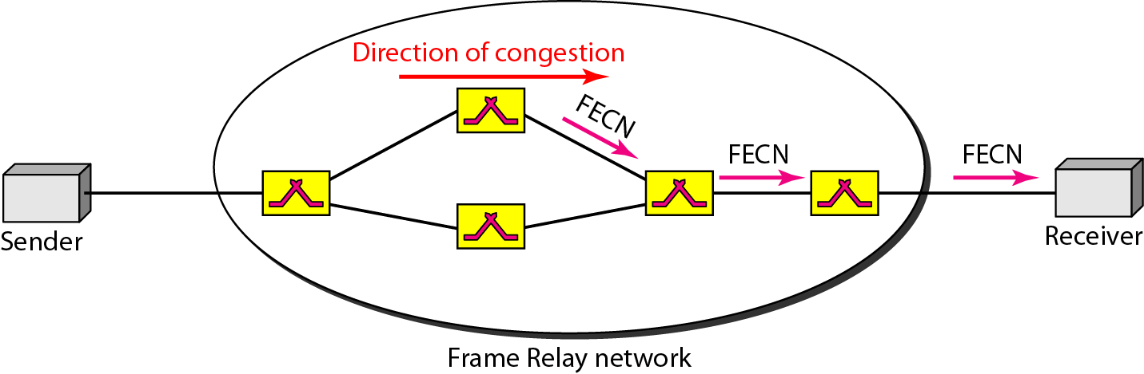
BECN and FECN in FR
Notes:
Backward / Forward explicit congestion notification

Slide 15
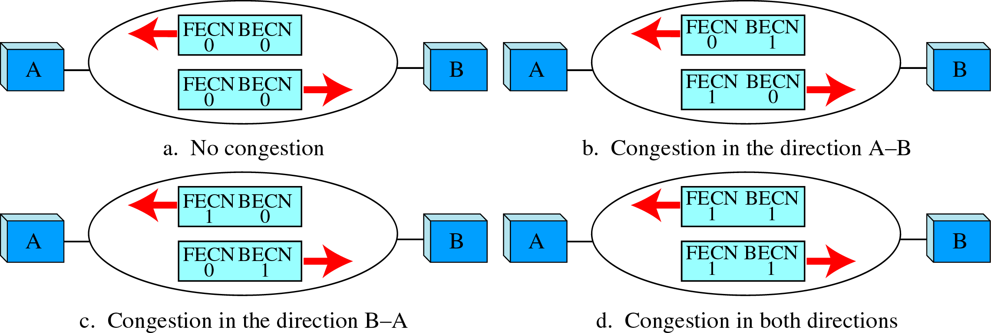
4 Cases of Congestion

Slide 16
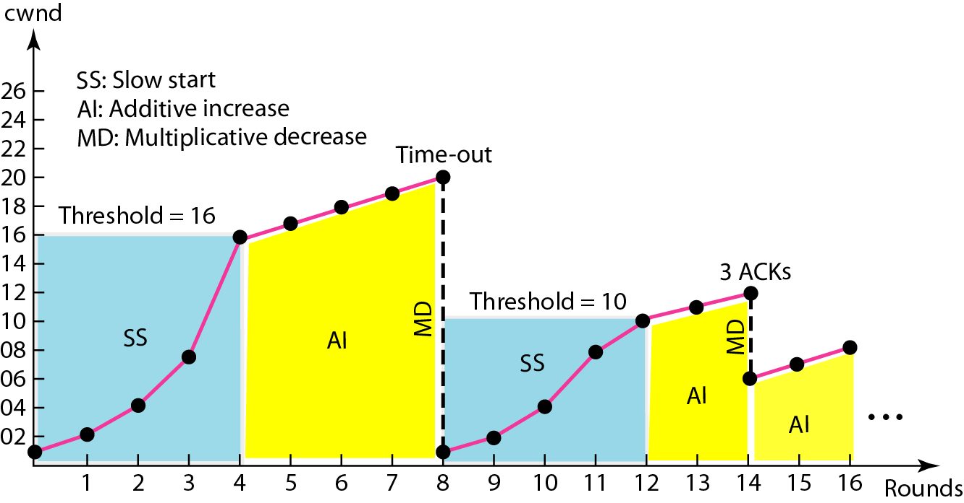
Congestion Window
Control congestion at hosts
Packet timeout as a signal of network congestion
Dynamic send window management (as in TCP) to hold the packet sending

Slide 17
Random Early Discard
Control congestion at routers (switches)
Combined with congestion window at hosts
Internet (TCP) global synchronization problem
Traffic burst fills queues so packets lost, TCP connections enter slow start
Traffic drops so network under utilized, connections leave slow start at same time causing burst again
Handle the problem – RED
Router randomly discards packets before buffer becomes completely full

Slide 18
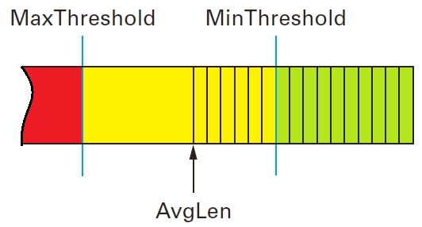
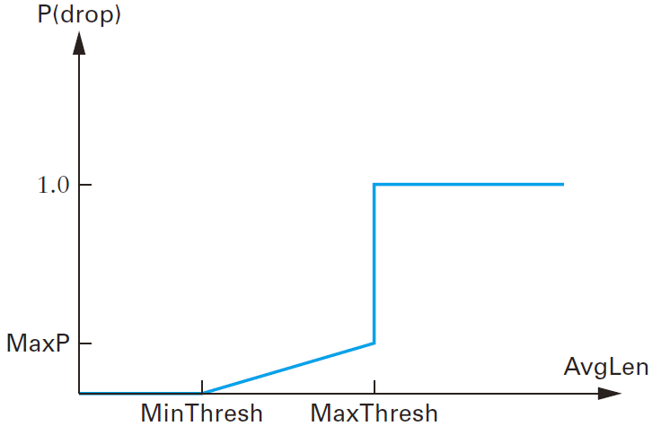
The RED Algorithm
Compute average queue length
avgLen = (1−ω)×avgLen+ω×sampleLen
Calculate average queue size avgLen
if avgLen < TH_{min}
queue packet
else if TH_{min} ≤ avgLen < TH_{max}
calculate probability p
with probability p discard packet
else with probability 1-p queue packet
else if avg ≥ TH_{max}
discard packet
Notes:
weight = 0.002 (0.02)
maxP = 0.02

Slide 19
Traffic Shaping
Shape the traffic (packet flow) before it enters the network
Control the rate at which packets are sent
At connection set-up, host and end switch negotiate a traffic pattern (shape)
Two traffic shaping algorithms
Leaky Bucket
Token Bucket

Slide 20
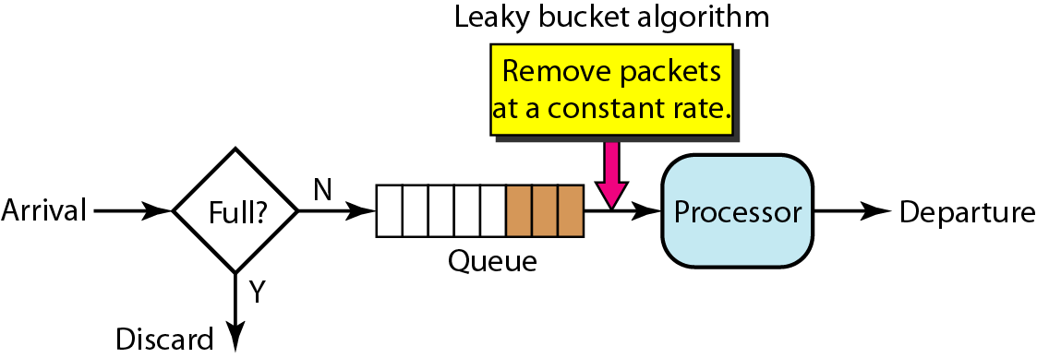
Leaky Bucket
Shape bursty traffic into fixed-rate traffic by averaging the data rate
May drop the packets if the bucket is full

Slide 21
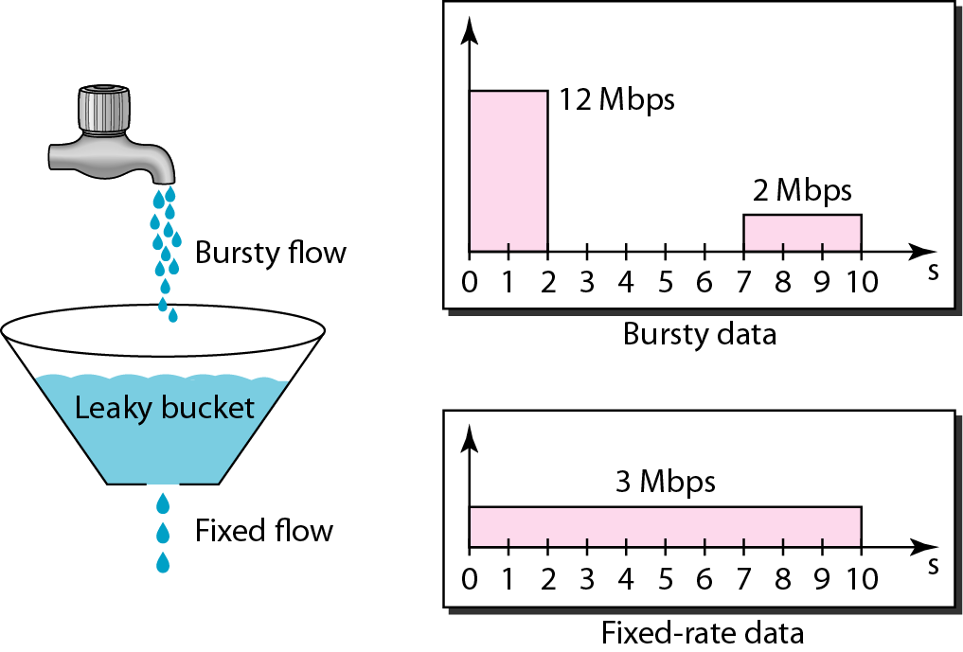
Leaky Bucket
Do nothing when input is idle
Packet output rate is fixed

Slide 22
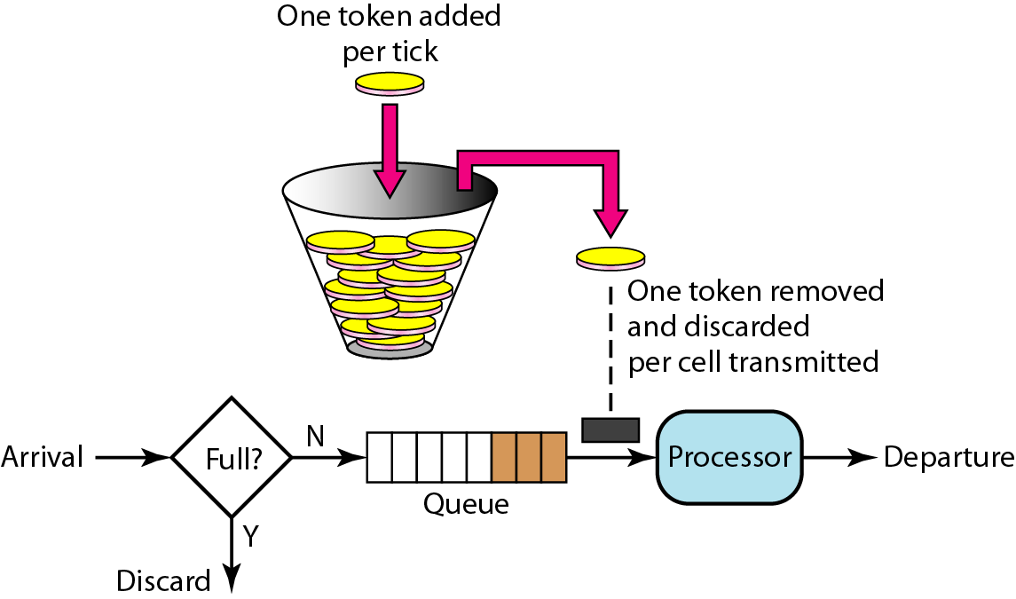
Token Bucket
Use token to control the output traffic, allowing vary output rate
Token generation rate is fixed, may drop token (not packet) when bucket full

Slide 23
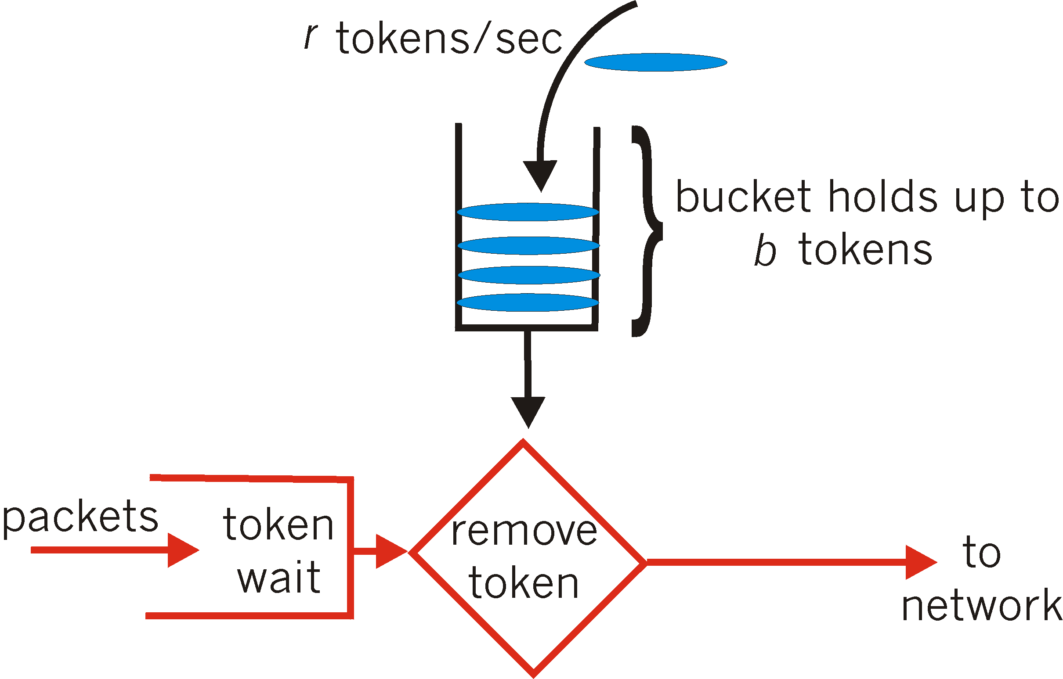
Token Bucket
Token bucket is more powerful in traffic shaping
3 metrics defined
Average traffic rate
Burst traffic rate
Maximum burst size

Slide 24
Congestion Control in FR
Explicit signaling use warning bits in packet
Backward/Forward explicit congestion notification
Traffic Rate Management
Define Committed information rate (CIR)
Congestion avoidance
Discard strategy

Slide 25
Committed information Rate
Average bandwidth (throughput) guaranteed for a virtual circuit
Aggregate CIR should not exceed line speed
Data in excess of CIR liable to discard, i.e. not guaranteed
2 metrics in CIR
Committed burst size (B_{c} in duration T)
Excess burst size (B_{e} in duration T)
Discard strategy
Data between B_{c}+B_{e} are permitted but not guaranteed
Data above B_{c}+B_{e} are discarded
Notes:
Discard Strategy

Slide 26
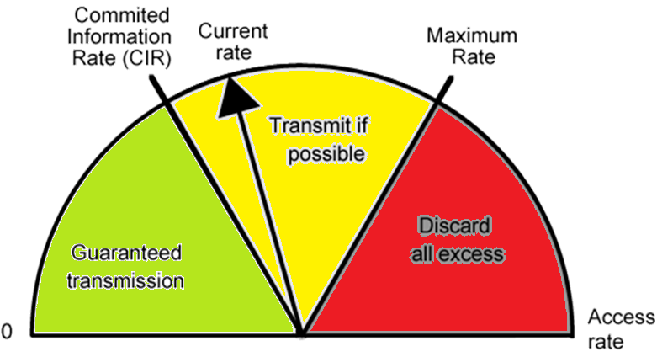
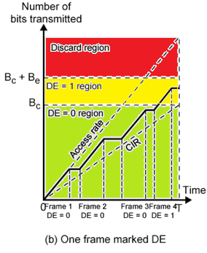
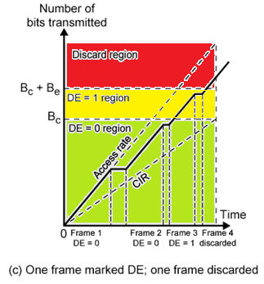
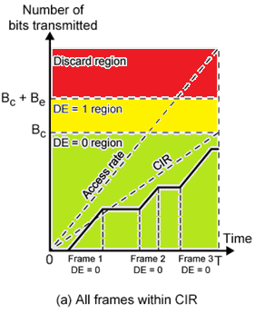
Operations of CIR
Notes:
DE: Discard Eligibility
单位时间

Slide 27
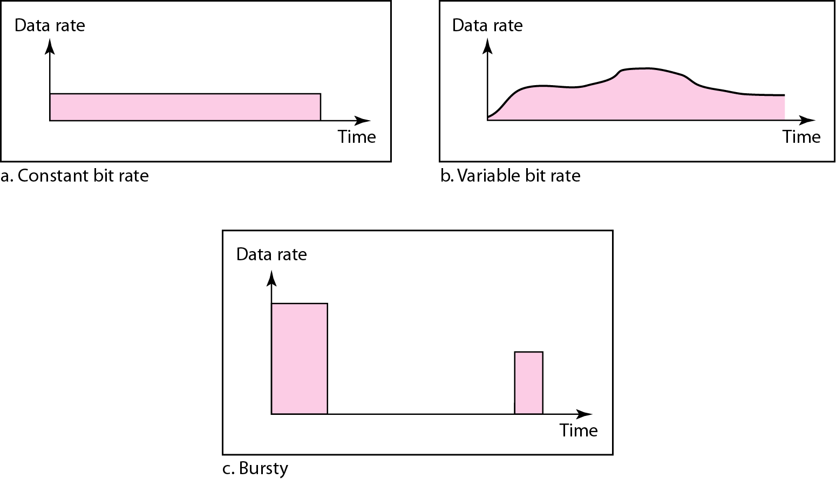
Traffic Management in ATM
ATM Peculiarities
Wide range of application demands, from several kbps to hundreds of Mbps
Different traffic patterns, from real-time traffic to bursty traffic
Different network QOS, from lost sensitive to delay sensitive
Real-time traffic not amenable to flow control (not draw back)
Traffic Patterns

Slide 28
Latency/Speed Effects
ATM transmission rate is 150Mbps
Time to insert a cell
Time to traverse network: ≈ 50x10⁻³ seconds
If using choking packet or timeout mechanism
By the time source knows a cell is dropped, number of wasted bits will be:

Slide 29
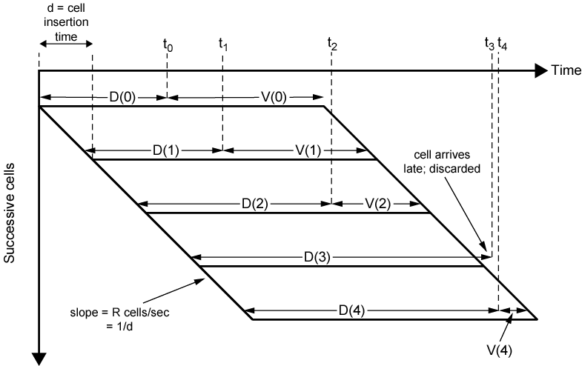
Real-Time Traffic
For ATM voice/video, data is a real-time stream of cells
There will always be some variation in transit
Cell delivery delay is needed to maintain constant bit rate at app

Slide 30
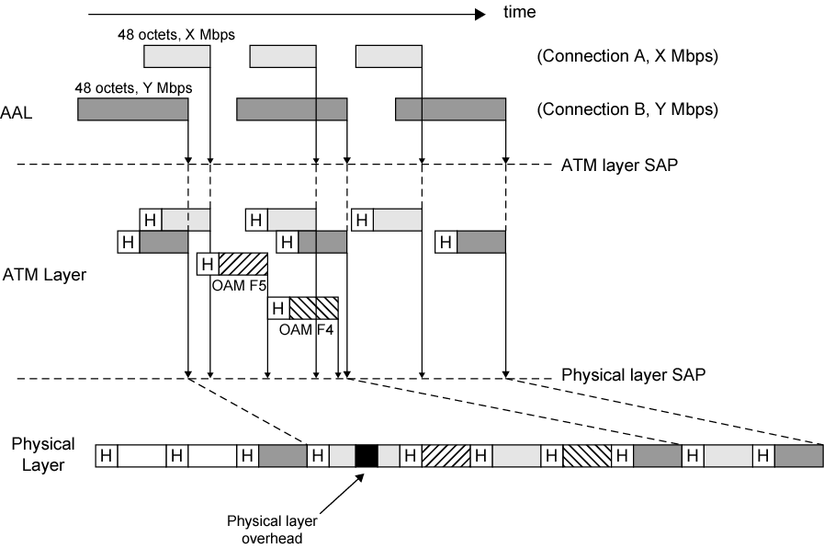
Cell Delay Variation
X>Y
Notes:
OAM: Operation, Administration, and Maintenance
F4, F5 is ATM OAM fault management, loopback, and continuity check (CC) cells
F4 used in VPs, F5 in VCs

Slide 31
ATM Traffic Control Functions
Resource management using virtual paths
Connection admission control
Usage parameter control
Traffic shaping using Token Bucket
Selective cell discard
Cell scheduling

Slide 32
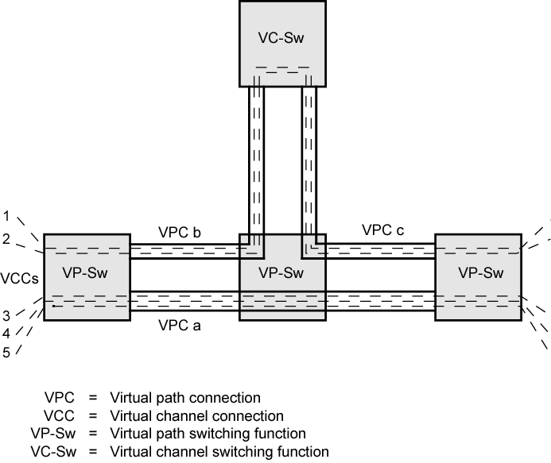
Resource Management Using Virtual Paths
Separate traffic flow according to traffic characteristics
User to User, User to Network, Network to Network
Cell loss ratio, Cell transfer delay Cell delay variation
VCs within a VP should experience similar network performance

Slide 33
Connection Admission Control
First line of defense
User specifies traffic characteristics for new connection (VC or VP) by selecting a traffic contract
Network accepts connection only if it can meet the demand
Traffic contract
Peak cell rate: max cell per second
Cell delay variation tolerance: millisecond diff tolerated
Sustainable cell rate: average cell per second
Maximum burst size: max number of cells in PCR
Notes:
VBR: for burst traffic (i.e. computer traffic)
PCR: cell per second
CDVT: Millisecond or us (microsecond)

Slide 34
Usage Parameter Control
Traffic policing
Monitor connection to ensure traffic conforms to contract
Based on traffic contracts
Combined with cell tagging
CLP: Cell Loss Priority
Variable bit rate connections
Constant bit rate connections

Slide 35
Parameter Control in VBR
Apply token bucket
Cells that exceed PCR are discarded
Cells that below SCR is ok
Cells that exceed SCR+MBS are either discarded or tagged with CLP=1
Cells that exceed SCR (<MBS) may be tagged with CLP=1
Suppose PCR set to 20Mbps, MBS set to 100 cells
Then time for burst will be

Slide 36
Parameter Control in CBR
Much like leaky bucket
Compute cell inter-arrival time d = 1/PCR
(d – CDVT) will be the tolerance limit
Tagging policy
Cells that exceed tolerance limit are discarded
Cells that below PCR is ok
Cells that exceed PCR but blow tolerance limit are either tagged or discarded

Slide 37
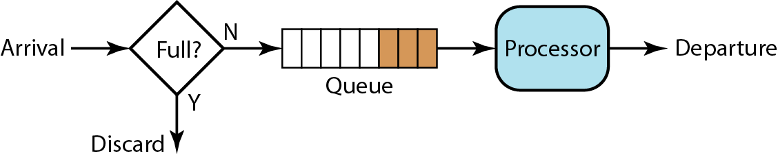
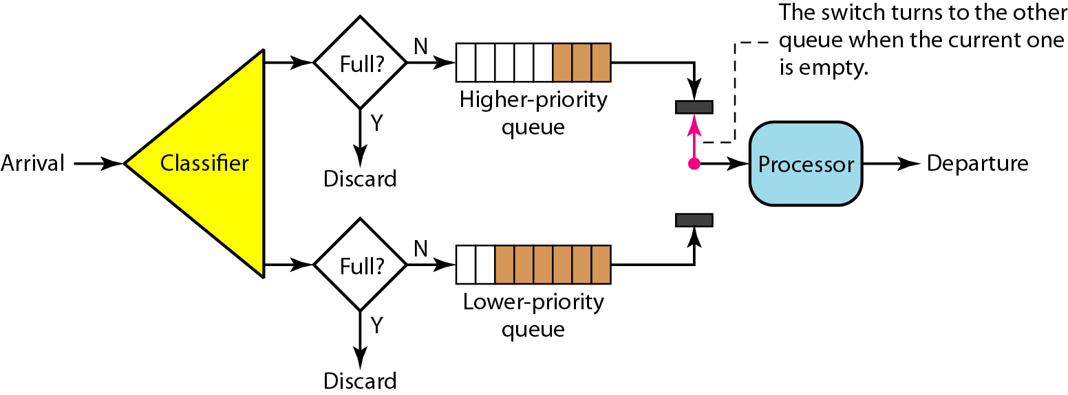
Cell Scheduling
On each switch, instead of FIFO queue, priority queuing is applied for each cell
Notes:
CLP == 1 ?

Slide 38
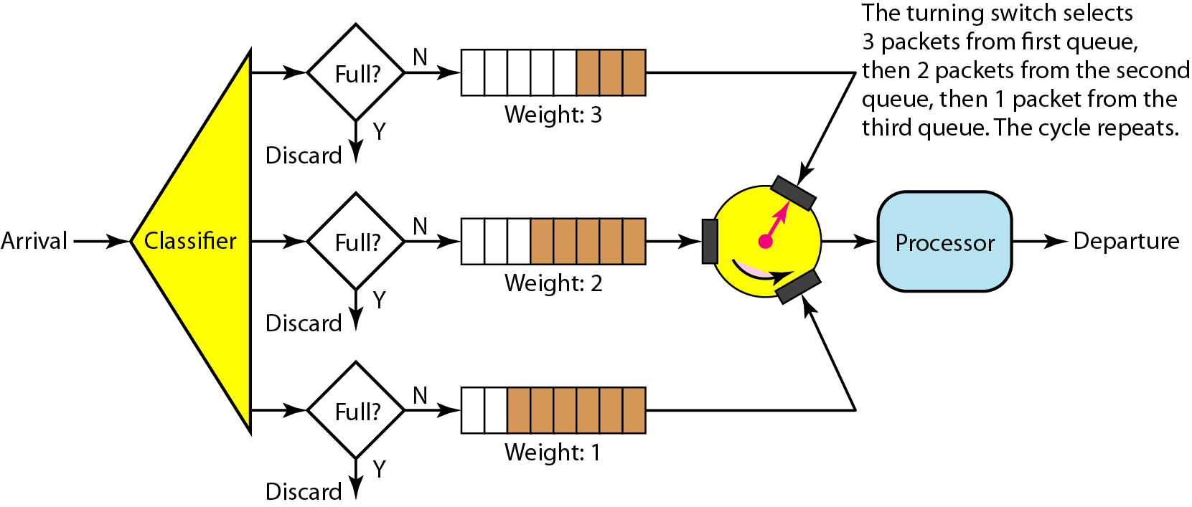
More Advanced Scheduling
Weighted fair queuing, scheduling based on VP or VC

Slide 39
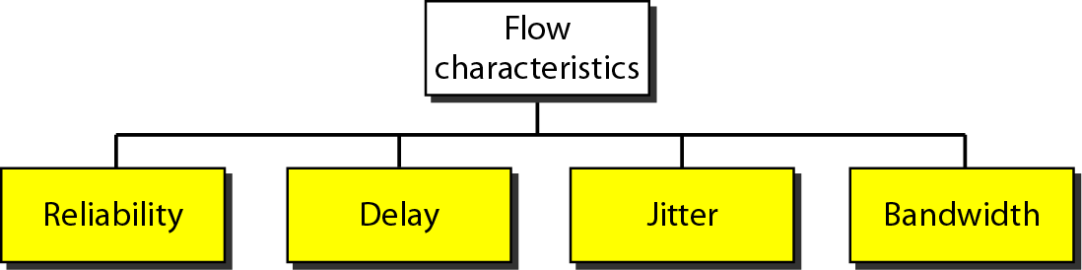
Internet QoS
New additions to Internet increasing traffic
High volume client/server application
Web with large amount of graphics
Real time voice and video
Must support Quality of Service (QOS) within TCP/IP
In place of “best-effort”
Add traffic control to routers
Provide means of requesting QOS

Slide 40
Traffic Requirements of Internet Apps
Application | Data Loss (Reliability) | Throughput (Bandwidth) | Time Sensitive
File transfer | no loss | elastic | no
Email | no loss | elastic | no
Web documents | no loss | elastic | no
Real-time audio/video | loss-tolerant | audio: 5k~1Mbps video: 10k~5Mbps | 100’s msec
Stored audio/video | loss-tolerant | same as above | few secs
Interactive games | loss-tolerant | few kpbs up | 100’s msec
Instant messaging | no loss | elastic | nearly

Slide 41
Requirements for Inelastic Traffic
Difficult to meet requirements on IP network
Require preferential treatment to handle variable queuing delays and congestion
Applications need to be able to state their requirements
Ahead of time, using resource reservation functions – ISA ( Integrated Services Architecture)
Or on the fly, using fields in IP header – DS ( Differentiated services)
Require elastic traffic to be supported as well
Inelastic application do not back off and reduce the demand in face of congestion
Deny (traffic) service requests that leave too few resources

Slide 42
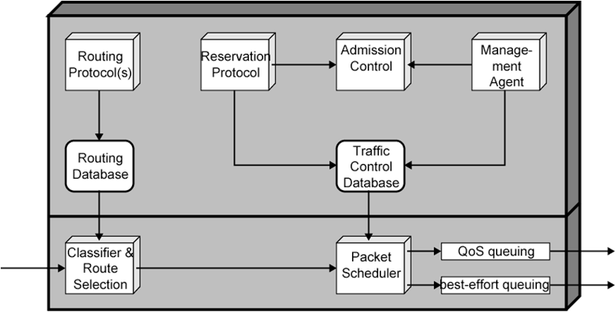
Integrated Services Architecture
Associate a distinguishable stream of IP packets with a flow
With the same QOS parameters
Identified by source and destination IP address, port numbers, protocol type (TCP or UDP)
Unidirectional, Can be multicast
ISA Functions on a router

Slide 43
ISA Functions
Routing Algorithm
Link cost based on a variety of QOS parameters, not just delay
Routing / forwarding based on classes of flows with similar QoS
Queuing discipline
Priority queuing
Multiple queues instead of one, taking account of different flow requirements
Discard policy
Selective discard instead of just new comings
Reservation protocol
RSVP, reserve resource for new flow at a given level of QOS
Notes:
Resource reservation protocol

Slide 44
ISA Functions
Admission control
Determines if sufficient resources are available for the flow at the requested QOS
Traffic control database
Parameters of traffic control
Management agent
Modifies the traffic control database
Directs the admission control module to set policies

Slide 45
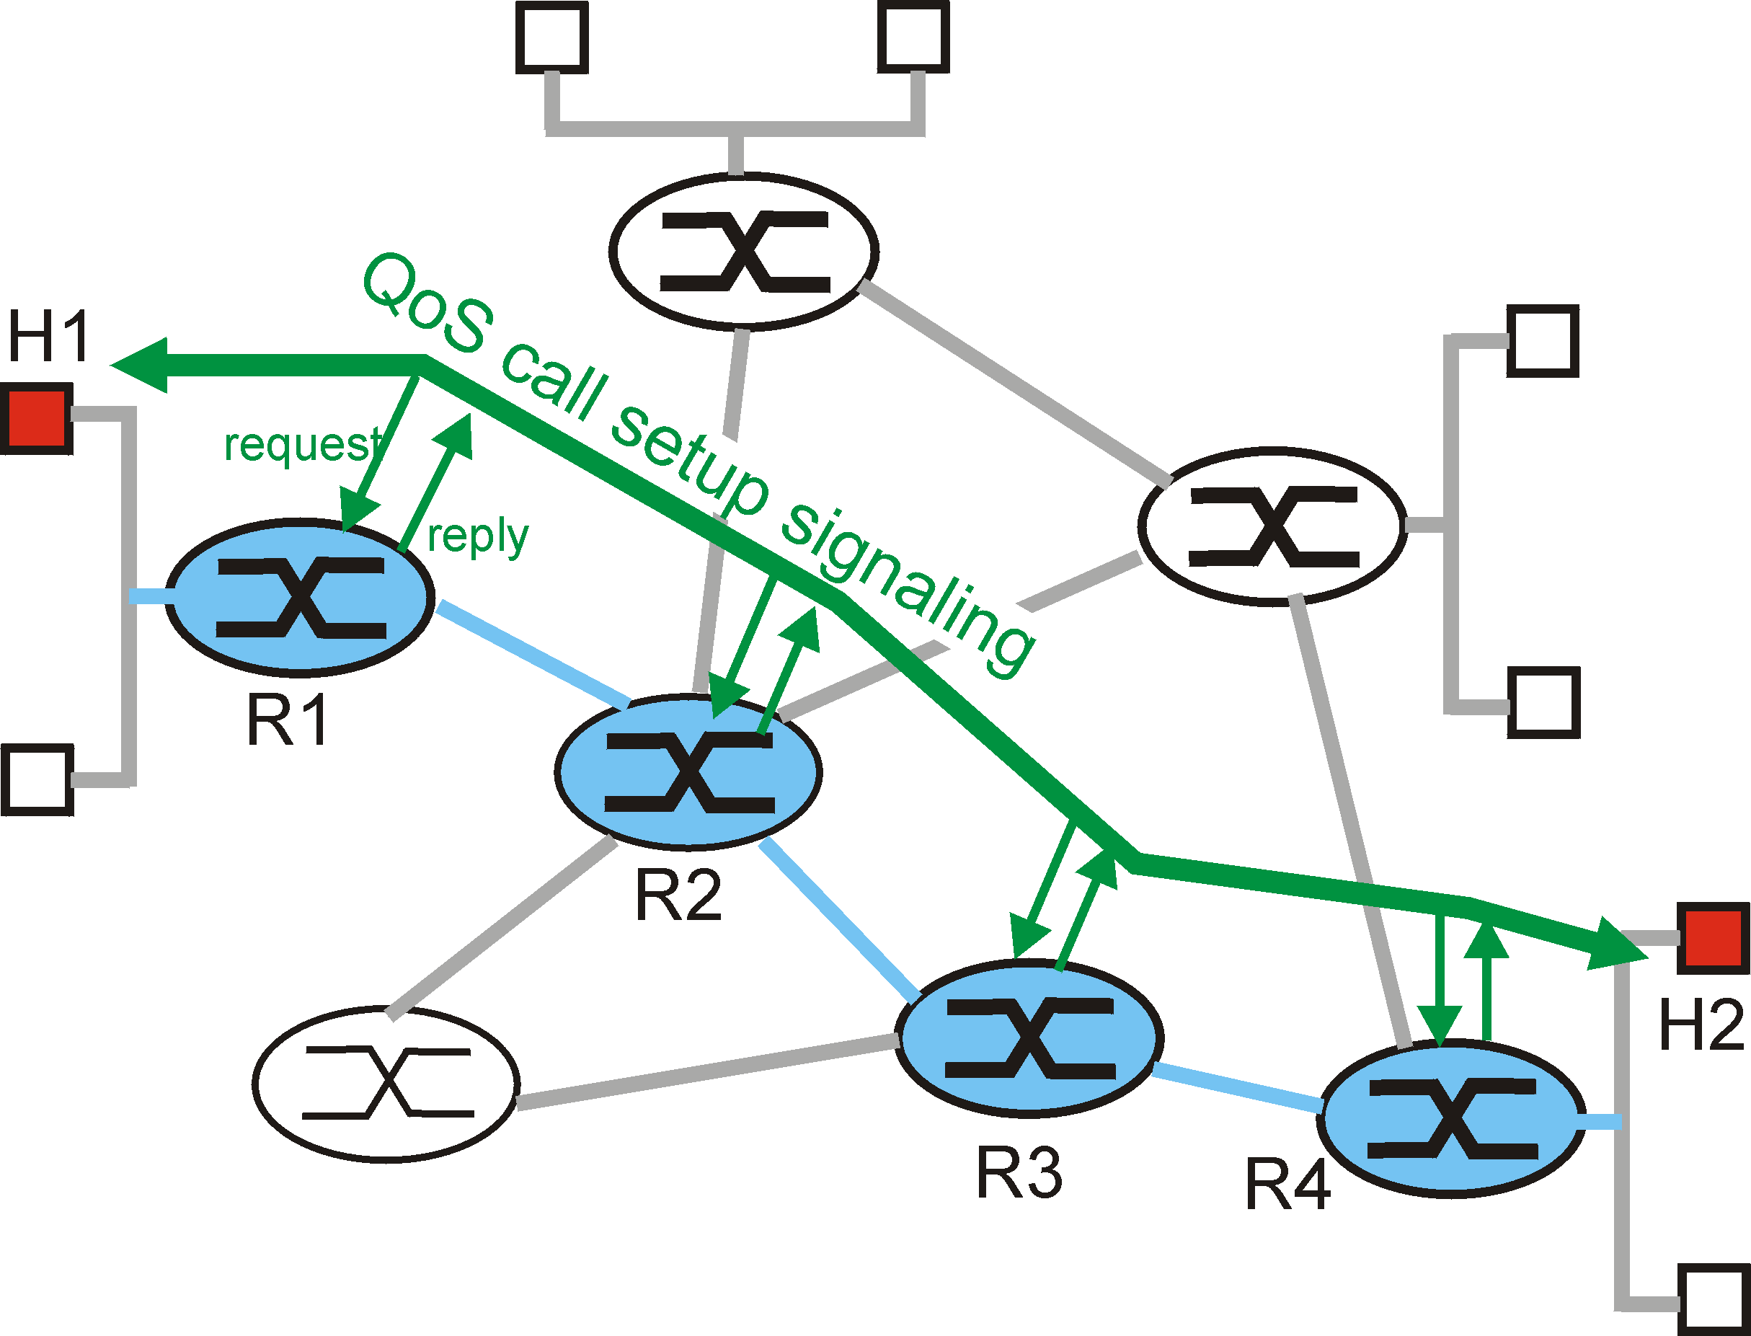
Resource Reservations
Routers need to maintain state info for each traversing flow
Maintaining records of allocated resources
A virtual circuit like mechanism is needed
Allocate resources for new connection (flow) setup requests

Slide 46
ISA Services
Defined on 2 levels
General categories of service
Guaranteed, Controlled load
Best effort (default)
Particular flow within each category
Specified by the values of QoS parameters
Traffic specification (TSpec) defined for flow of packets
Traffic that exceeds TSpec is given the best-effort service

Slide 47
Guaranteed and Controlled Load
Guaranteed Service
Set upper bound on queuing delay through network
No queuing losses
Assume leased line
Controlled Load
No upper bound on queuing delay, but has priority scheduling on router
Very high percentage delivered
For Internet video and voice apps

Slide 48
Resource Allocation and RSVP
Providing QOS guarantees in IP networks for individual application sessions
Resource reservation: routers maintain state info of allocated resources for each session
Admit or deny call setup requests for a new session

Slide 49
Data Flow in a Session
Session
Unidirectional, acquired by a receiver
A data flow with a particular destination and transport layer protocol
Defined by the triple: <DestAddress, Protocol ID, DstPort>
Reservation Model
An RSVP request consists of a flow descriptor: <R-Spec, T-Spec>
R-Spec: specifies a desired QOS, used to set parameters in the packet scheduler
T-Spec: defines traffic characteristics under QOS, used to set the packet classifier
Notes:
流约定：delay, throughput, lost, …
筛选：token bucket – Rate, Burst

Slide 50
Resource Reservation Protocol
RFC 2205
IP signaling protocol for multimedia applications
Reserve resources along end-to-end path (routers) for QoS support
Designed to operate with current and future unicast and multicast routing protocols
Features
Ability for receivers to make reservations, transparent operation through non-RSVP routers
Support for IPv4 and IPv6, independent of routing protocol
Deal with changes in dynamic routes
Deal with changes in multicast group membership

Slide 51
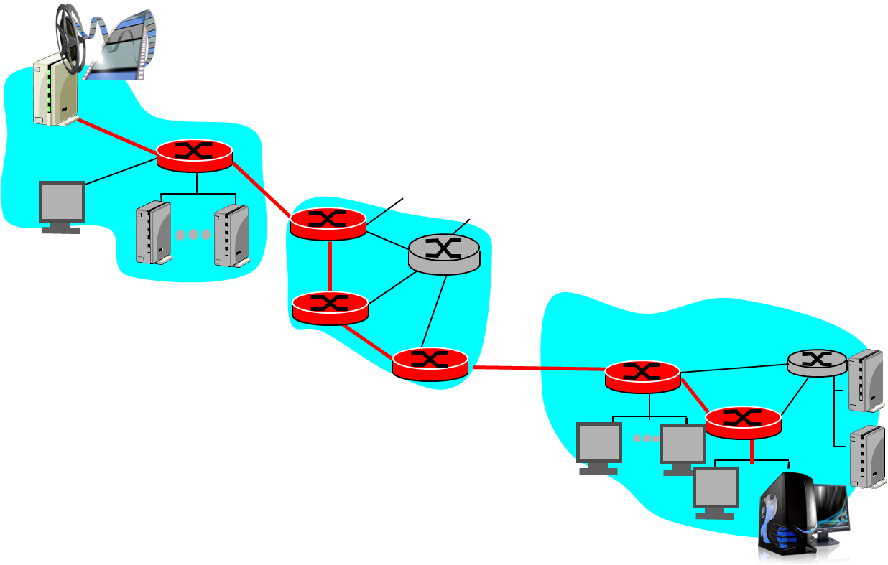
RSVP Scenario
Resource reservation
call setup, signaling (RSVP)
traffic, QoS declaration
per-element admission control
request/
reply
QoS-sensitive scheduling (e.g., WFQ)

Slide 52
RSVP Reservation Process
Receivers
Make RSVP msgs carrying reservation requests
Pass the msgs upstream towards the senders
Scope of the request
The set of sender hosts to which a reservation request is propagated
At each intermediate router
The RSVP module passes the request to Admission and Policy control and the check is executed
Maintain soft state (periodically renewed) for each session
Reservation request is propagated upward

Slide 53
RSVP Mechanisms (1)
2 fundamental RSVP messages
Path: from sender, pass downstream
Resv: from receiver, pass upstream
Path message
RSVP sender transmits a Path message downstream, store the path state in each router along the way
The path state includes the IP address of the previous hop which is used for reverse directing
May gather information that can be used to predict the end to end QOS

Slide 54
RSVP Mechanisms (2)
Resv message
Each receiver sends a Resv message upstream towards the senders
Follows the exact reverse path the data will use (path state)
Creates and maintains the reservation state in each node along the path

Slide 55
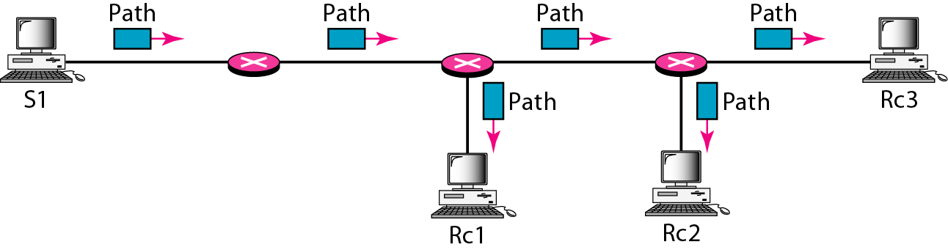
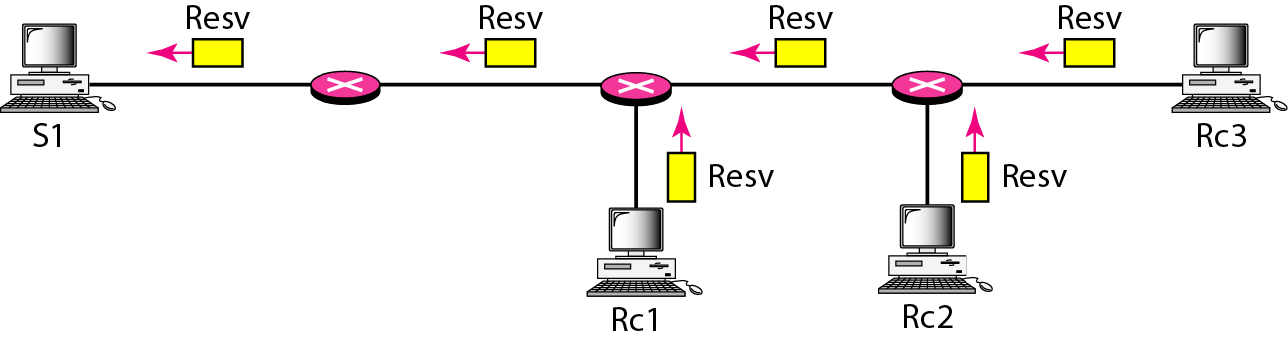
RSVP Messages

Slide 56
Soft State
Manage the reservation state and/or path state in routers and hosts
A soft state is created and periodically refreshed by Path and Resv messages
Must interact with dynamic routing strategy of Internet
When the route changes, the resource reservation must be changed
Apps must periodically renew requests during transmission, or the state info will expired
Teardown msgs can be used to remove path or reservation state immediately

Slide 57
RSVP Operation for Multicast
Receiver joins a multicast group (IGMP)
Sender-to-network signaling
Potential sender issues Path message
Receiver gets the message identifying sender
RSVP router records reverse path info along the mcast tree
Receiver-to-network signaling
Receiver start sending Resv messages
Resv messages propagate through mcast tree and is delivered to sender
Path / Reservation teardown
Remove sender’s path state and receiver reservations

Slide 58
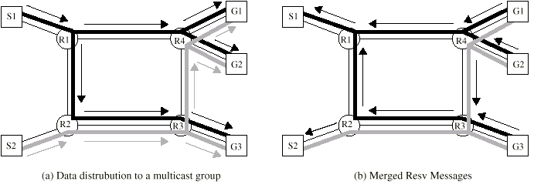
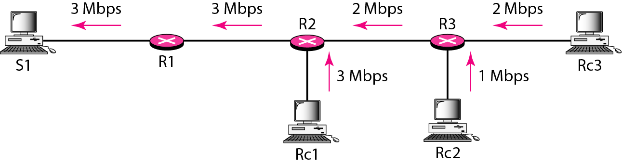
RSVP Operation for Multicast
Reservation merging

Slide 59
Differentiated Services
ISA (and RSVP) complex to deploy now
Signaling, maintaining per-flow router state not scale well for large volumes of flows
RFC 2475
Provide simple, easy to implement, low overhead mechanism
Support range of network services differentiated on basis of performance
Simple functions in network core, relatively complex functions at edge routers
Notes:
量体裁衣 vs. 按标准号

Slide 60
Characteristics of DS
Use IPv4 header Type of Service or IPv6 Traffic Class field
Define Service level agreement (SLA)
Established between provider (ISP) and customer prior to use of DS
Apps only need to select appropriate DS, and all traffic with same DS field treated same
e.g. multiple voice connections
Classification and Conditioning
Per-Hop-Behavior (PHB, queuing and forwarding) determined based on DS field
Edge router classifies and shapes the non-conforming traffic
Notes:
Internet Service Provider

Slide 61
Service Level Agreement
Define service performance parameters
Expected throughput, latency
Drop probability
Jitters
Define Traffic profiles to be adhered to
e.g. token bucket parameters
pre-negotiated rate r, bucket size B
Disposition of traffic in excess of profile
Constraints on ingress and egress points
Indicate scope of service
Notes:
参数设置

Slide 62
Example Services
Qualitative
Level A – low latency
Level B – low loss
Quantitative
Level C – 90% of traffic < 50ms latency
Level D – 95% in profile traffic delivered
Mixed
Level E – allotted twice bandwidth of level F traffic
Level F – traffic with drop precedence X, higher probability of delivery than that with Y

Slide 63
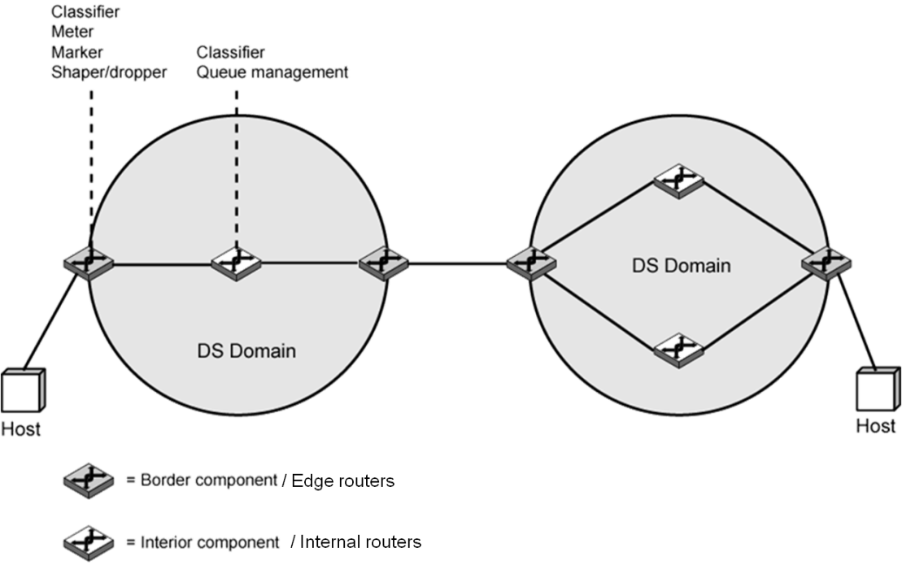
DS Domain
Provided by singular ISP or group of ISPs
Contiguous portion of internet over which consistent set of DS policies administered
i.e. Similar explanation and handling of SLA parameters
Service provider configures domain edge routers
Customer may be hosts or edge routers in other domain
Ongoing measure of performance provided for each class
Match the most appropriate service (class) for traffic from other domain

Slide 64
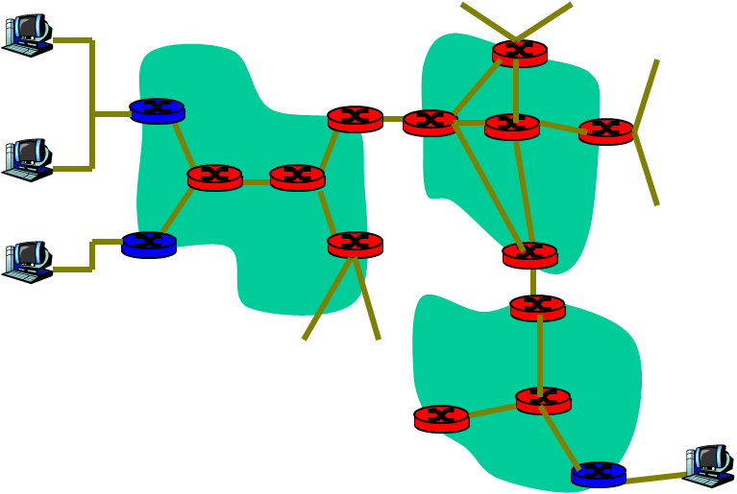
DS Architecture
Edge router
Per-flow traffic management
Marks packets as in-profile and out-profile
Internal router
Per class traffic management
Buffering and scheduling based on Marking at edge
Preference given to in-profile packets
scheduling
marking
r
.
.
.
B

Slide 65
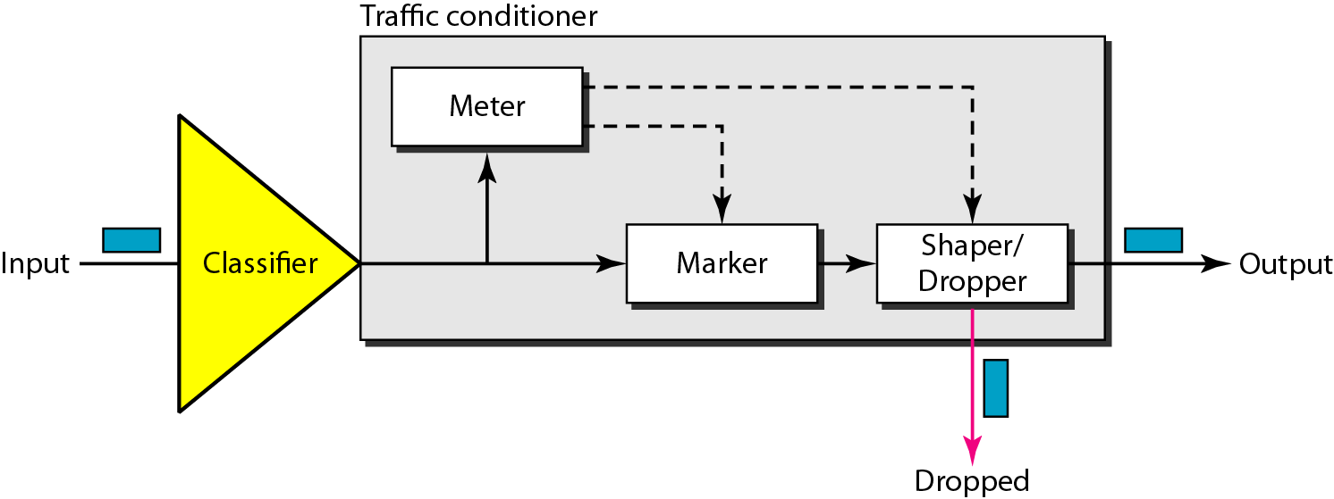
Functions of Edge Routers
Traffic classification and conditioning per flow
Classifier: separate packet flows into classes
Meter: measure flow traffic for conformance to profile
Marker: policing by remarking code-points if required
Shaper: shaping packet flow using token bucket
Dropper: drops packets if flow rate exceeds too much those specified in the class profile

Slide 66
Functions of Internal Routers
Consistent interpretation of DS code-points within domain
Simple mechanisms to handle packets based on code-points (Class)
Classifier
Differentiate packets based on DS code-point, src & dst addresses, high-level protocol, etc.
Queue Management
Per Hop Behavior (PHB): queuing gives preferential treatment depending on code-point
Packet dropping rule dictates which to drop when buffer saturated

Slide 67
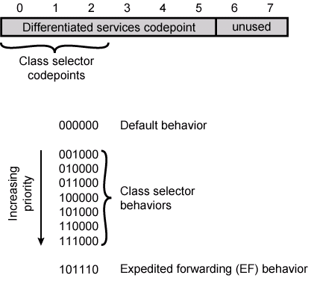
DS Code Points
Leftmost 6 bits are DS code-point
64 different classes available
Rightmost 2 bits unused
3 pools defined
xxxxx0 : reserved for standards
000000 : default packet class
xxxx11 : reserved for experimental or local use
xxxx01 : allocated for standards in future

Slide 68
Per Hop Behavior
For each hop (router) in a DS domain
Defines the policy and priority applied to a packet with specific DS
Results in a different observable (measurable) forwarding performance
2 PHBs under consideration
Expedited Forwarding
Assured Forwarding

Slide 69
PHB – Expedited Forwarding
RFC 3246
Support for premium service
Low-loss, low-delay, low-jitter; assured bandwidth, end-to-end service through DS domains
Appears to endpoints as point-to-point connection or leased line
Difficult in current Internet
Queues at each router will result in loss, delays, and jitter
Define the minimum departure (guaranteed) rate
Condition aggregate so arrival rate at internal routers is always less than minimum departure rate
In-profile EF traffic is given absolute queuing priority
Notes:
快速转发
公交专用车道

Slide 70
PHB – Assured Forwarding
RFC 2597, provides ranked services superior to best-effort
Based on explicit allocation on routers, do not require reservation of resources
4 classes of service defined
Each describes different traffic profile, including aggregate data rate and burst size
In DS domain, traffic from different classes treated separately, with different amounts of resources (buffer space or bandwidth)
Within each class, packets marked with one of 3 drop precedence values
Traffic monitored at edge router, each packet marked in or out of profile
Notes:
4×3=12种不同的profile
确保转发

Slide 71
Assured Forwarding Characteristics
Performance of forwarding depends on
How much forwarding resources allocated to each class that the packet belongs to
Current load of the class
If congested within the class, drop precedence of packet
Simplicity
Very little work required by internal routers
Marking of traffic at edge routers provides different levels of service to different classes
Interior routers use RED algorithm to manage DS traffic
Notes:
Random Early Discard

Slide 72
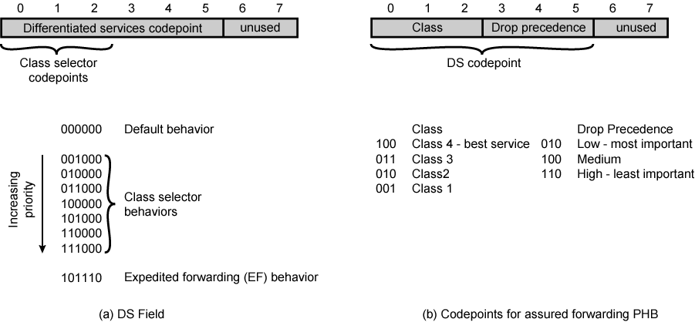
DS Field in Detail

Slide 73
Chapter Goals
Understand principles of Network QoS
Queues at Switch and Network Congestion
Mechanisms for Congestion Control
Mechanisms for providing QoS
Token Bucket and RED
Congestion control and QoS in Practice
Congestion control in FR
Traffic management in ATM
Internet QoS: RSVP and Differentiated Services
Notes:
Random Early Discard

